Slide 1

PLANNING WITH
HARD TO VALUE ASSETS
Isabel R. Araújo, MBA, CTFA, AEP®, Senior Manager, Trust Services Consulting,
Charles Schwab Trust Company of Delaware
Theresa L. Hughes, CTFA, AEP®, Professional Individual Trustee
Mark Lingerfield, Manging Director, MPI

Slide 2





COUNTDOWN TO
SURVEY QUESTION 1
2025
PART 1: PLANNING IN THE NOW
PART 2: ASSET VALUATION PROCESS
PART 3: ROLE OF ADVISORS
2

Slide 3

SURVEY QUESTION 1
HAVE YOU STARTED DISCUSSIONS WITH YOUR CLIENTS ABOUT PLANNING FOR 2025?
YES/NO POLL
3

Slide 4
PART ONE
START PLANNING
PLANNING IN THE NOW
1
Considerations: Planning should be in process no later than July 2025
Perspectives
Who are the players?
  Attorney
  Trustee
  Financial Advisors
  Family Office
  Most importantly, the client
2
Roadblocks: Client cooperation & information flow between players
3
Solutions to getting to the finish line
4

Slide 5
SURVEY QUESTION 2
HOW LONG WILL IT TAKE TO COMPLETE AN APPRAISAL ON:
1. REAL ESTATE LLC
    10 DAYS
    30 DAYS
    45 DAYS
2. MARKETABLE SECURITIES LLC
    10 DAYS
    30 DAYS
    45 DAYS
3. OPERATING COMPANY
    20 DAYS
    30 DAYS
    60 DAYS
MULTIPLE CHOICE
5

Slide 6
PART TWO
ASSET VALUATION PROCESS
  LLCs and RE Holding Companies
  LLCs and Securities Partnerships
  Operating Companies
Consideration: corporate trustees typically have LLC and closely held committees who must review operating documents as well
6
Notes:
Theresa- asks Mark the leading questions about the valuation process, taking into consideration the polling questions/answers
Mark- provides details on valuation process, hiccups, etc Horror stories- pressures coming from the Trustee, attorney, esp client has not provided all docs (segue way to next slide)
Theresa- also pivots to get bank/trust company perspective as to review procedures- Isabel and Theresa

Slide 7


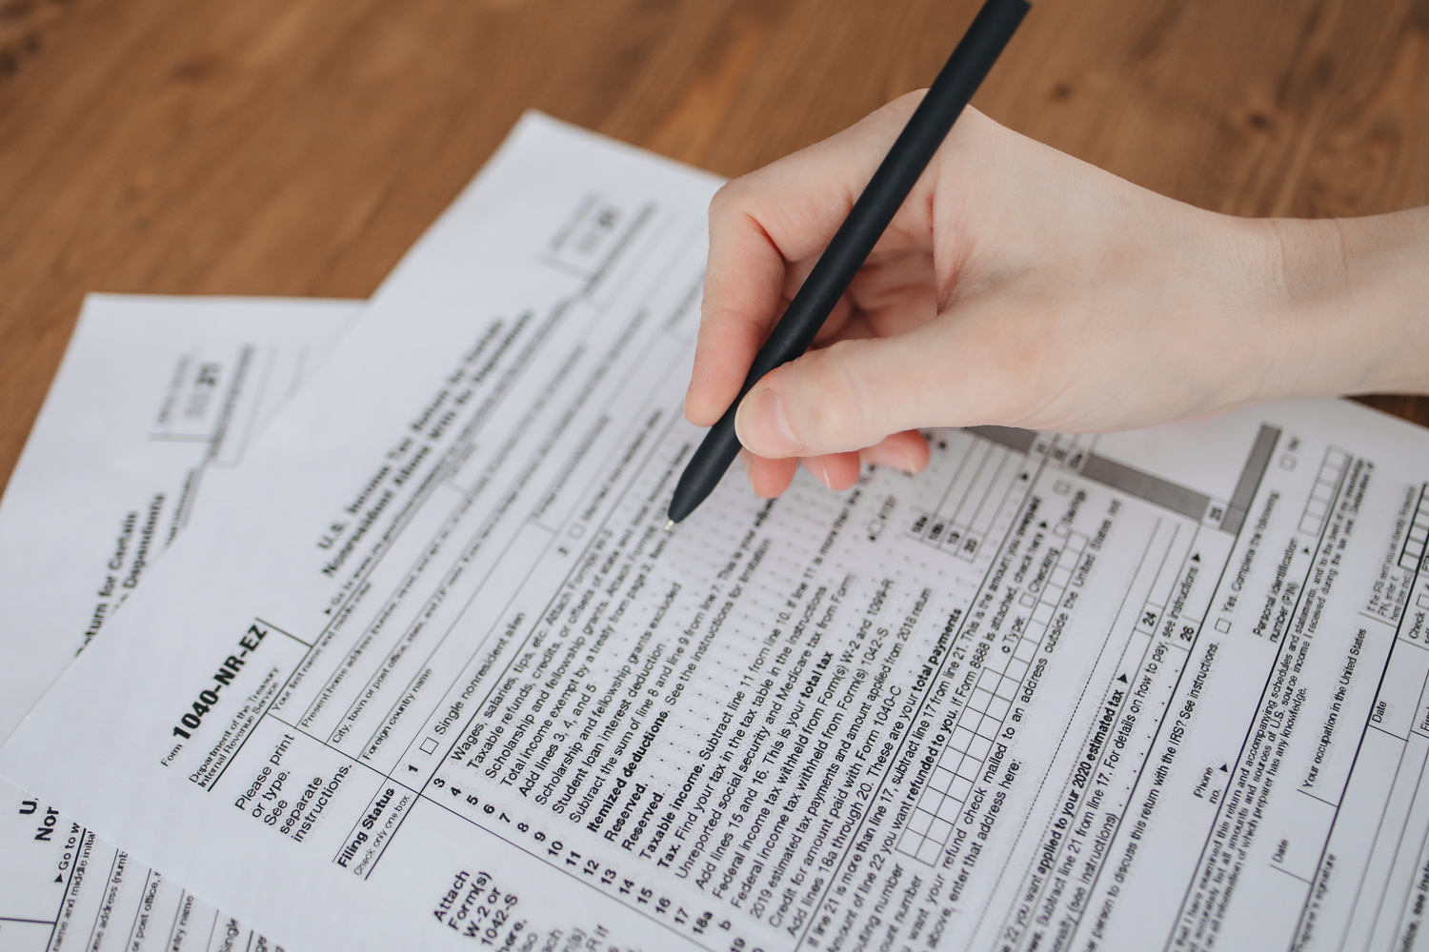

DOCUMENT
GATHERING
Important for the players to prepare the client
  Establish time frames for various assets
  Types of items needed for qualified appraisal
If all of the items needed are not fulfilled, a lesser appraisal can be completed but it is not optimal.
7
Notes:
This slide is for Mark to start
Types of items needed for qualified appraisal (Mark provides details on docs he needs)
. (Not great for clients, Trustee, appraiser due to IRS exposure if challenged right away, and adequate disclosure not met) Theresa: asks Mark- what is your recourse? How do you move forward, do you move forward? Non-acceptance if clients are demonstrating lack of seriousness or resignation from engagements. Issue: minority investors in non-family entities/owned company- can’t leverage company to provide documents in real time/timely fashion.

Slide 8
PART THREE
ROLE OF THE ADVISORS
When does the Trustee cut off the planning?
Let the client know that transparency is key.
TRUSTEE
APPRAISER
Complete and explain the valuation to client and advisors
The development of the estate and tax plan as well as drafting the trust instruments and assisting the client with decisions regarding funding assets
ATTORNEY
8

Slide 9
LESSONS FROM 2012
1
Trustee deadlines as to pre-acceptance process
2
Attorney may be unable to complete drafting
3
Anecdotes from Isabel and Theresa
9
Notes:
Isabel & Theresa- talk of need of drop dead dates, internal processes (approvals of acct opening/LLC committees/gathering KYC docs)
based on their own timelines, busy clients traveling (holidays)
Isabel (late entry client, atty had to step in as Trustee. Theresa- valuations story/valuation updated later

Slide 10
YOUR THOUGHTS
COMMENTS AND
QUESTIONS
10

